Slide 1
CODESPARK HACKATHON 2026 • PROBLEM STATEMENT 22
Digital Student Helpdesk
AI-Powered Academic & Administrative Support Portal with Full-Stack Java Spring Boot Backend & Python NLP Query Routing
TEAM MEMBERS & STUDENT IDS
Sri Charan
A. Rishi
P. Sudha
ID: 252003093
ID: 2520030268
ID: 2520030455
Department of Computer Science & Engineering
KL University — Bachupally Campus

Slide 2



01. PROJECT THEORY & CONTEXT
Problem Statement & System Objectives
The Administrative Bottleneck
The Digital Solution
Primary System Goals
University helpdesks face high ticket volumes across examination, fees, hostels, and academics. Manual ticket triage causes slow resolution, lost queries, and breached SLAs.
EduDesk AI delivers a centralized digital helpdesk. It automatically extracts intent, calculates urgency, tags keywords, and routes requests to department staff with draft AI responses.
Provide transparent ticket tracking for students, streamlined Kanban operations for staff, and real-time SLA compliance analytics for university leadership.
Core Problem
Core Innovation
Target Outcome
Inconsistent query routing & delayed resolution
Automated NLP triage & SLA tracking
Sub-4 hour resolution for urgent queries

Slide 3
02. FUNCTIONAL BREAKDOWN
Core Application Modules & Expanded Capabilities
1. Student Portal Module
2. Staff Operations Workspace
Self-service support hub allowing students to submit natural language queries, track progress across stages, receive automated initial resolutions, and provide 5-star feedback ratings upon closure.
Unified admin dashboard for department officers to handle incoming ticket queues, balance workloads, reassign tickets to domain specialists, and insert quick response templates.
•
Dual View Modes: Filterable tabular list & drag-and-drop style Kanban columns.
•
•
Template Engine: Pre-built standard resolution responses for frequent issues.
Real-Time Modal Assistant: Instant NLP keyword auto-suggestions during typing.
•
•
SLA Warning System: Visual timers alerting staff to approaching deadline thresholds.
Audit Timeline: Detailed interaction logs between student and department staff.
•
Role RBAC: Secure JWT-based student authentication & profile data binding.
Key Capabilities:
Key Capabilities:
Status timeline tracking • Multi-department routing • Feedback ratings • Instant ticket creation
Table & Kanban view • Re-assignment tools • Quick templates • Urgent priority alerts
3. Python NLP Classifier Sandbox
4. Analytics & SLA Compliance Engine
Interactive testing playground simulating Python's NLP intelligence model. Evaluates sentiment intensity, entity recognition accuracy, confidence scoring, and knowledge base matches.
Data visualization dashboard compiling metrics across departments, monthly resolution trends, average processing times, and university SLA compliance records.
•
Chart.js Visuals: Interactive doughnut and bar charts for departmental loads.
•
•
Audit Exporter: One-click CSV generation for administration oversight.
Preset Testing: Instant query presets for Hall Tickets, Fee Refunds, and WiFi issues.
•
•
Satisfaction Ratings: Aggregated student feedback scores per department officer.
Confidence Scoring: Real-time precision percentage assessment (80%-98%).
•
Entity Extraction: Auto-detects keywords like "Hall ticket", "UPI Payment", and "AC Leak".
Key Capabilities:
Key Capabilities:
Live text classification • Test presets • Confidence threshold • Auto-KB matching
Dynamic Chart.js metrics • Department efficiency audit • Downloadable CSV reports

Slide 4
03. TECHNOLOGY STACK
Software Architecture & Tech Stack
Backend Architecture
Intelligence Layer
Frontend UI / UX
Java Spring Boot (Primary Core)
Python NLP Microservice
Modern Glassmorphism Single-File App
•
Spring MVC REST API endpoints
•
Query intent classification
•
Tailwind CSS styling framework
•
Spring Data JPA & Hibernate ORM
•
Entity extraction & keyword tagging
•
Font Awesome 6 icon library
•
Spring Security role access
•
Priority & SLA estimation model
•
Chart.js analytics visualization
•
MySQL / PostgreSQL persistence
•
Knowledge base auto-resolution
•
Fully responsive reactive layout

Slide 5

04. INTELLIGENCE ARCHITECTURE
AI Query Triage & Processing Lifecycle
STAGE 01
STAGE 02
STAGE 03
STAGE 04
STAGE 05
Query Ingestion
NLP Intent & Entity Parse
Priority & SLA Scoring
KB Matching & Draft Response
Smart Dept Dispatch
Student submits unstructured query in free-form natural language text via portal modal or REST API endpoint.
Python model tokenizes text, detects sentiment intensity, and extracts key entities (e.g., "Hall ticket", "Fee refund").
Urgency scoring matrix determines priority (Urgent, High, Medium, Low) and sets strict SLA countdown targets (4h to 48h).
Routes query directly into assigned officer's queue (Exam, Finance, Hostel, IT, Transport, Academic).
Knowledge Graph matches query against past resolutions and auto-generates a draft resolution response for staff.
Payload: Subject + Description string
Tokens: Entities + Sentiment Score
SLA Rules: Urgent (4h) • Low (48h)
Draft: Knowledge Base Suggestion
Routing: Direct Officer Queue
Zero Manual Triage Latency
92.6% Classification Accuracy
Sub-4h SLA Target
Eliminates misrouted queries across Examination, Finance, Academic, Hostel, IT Support & Transport desks.

Slide 6

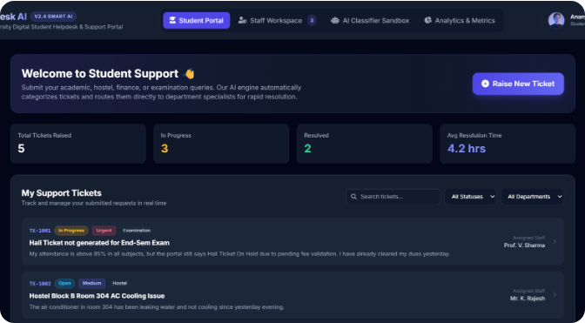
05. APPLICATION FEATURE WALKTHROUGH
Student Support Portal & Ticket Management
Real-Time Status Tracking
Students view active tickets, department assignments, and SLA status instantly.
Integrated Ticket Raising
Interactive modal form equipped with live NLP keyword suggestions to categorize queries.
Instant Filtering
Filter by status (Open, In Progress, Resolved) and academic departments.

Slide 7
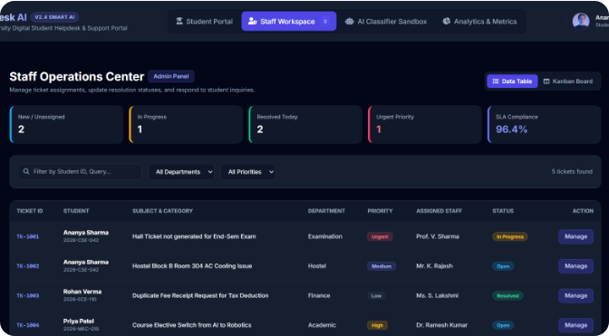
06. APPLICATION FEATURE WALKTHROUGH
Staff Operations & Management Center
Real-Time Operations KPIs
Displays open queries, urgent priorities, and daily SLA compliance (96.4%).
Flexible View Switcher
Toggle between detailed Data Tables and visual Kanban workflow boards.
Targeted Staff Assignment
Assigns queries directly to specialists (Prof. V. Sharma, Ms. S. Lakshmi).

Slide 8
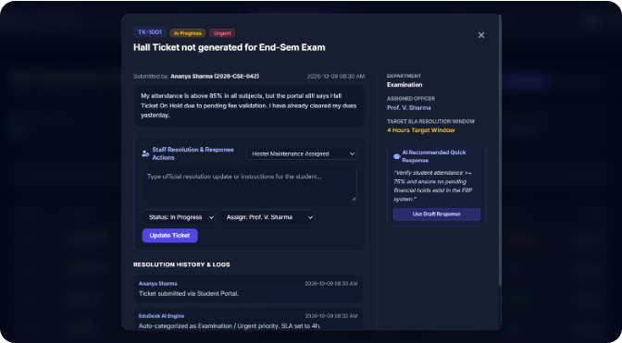
07. APPLICATION FEATURE WALKTHROUGH
Resolution Management & AI Response Drafts
AI Draft Copy Integration
One-click copy from AI NLP suggestions into official response input boxes.
Audit History & Logging
Complete timestamped interaction history between student and assigned staff.
SLA Countdown Window
Displays target resolution window (e.g. 4 Hours Target Window for Urgent tickets).

Slide 9
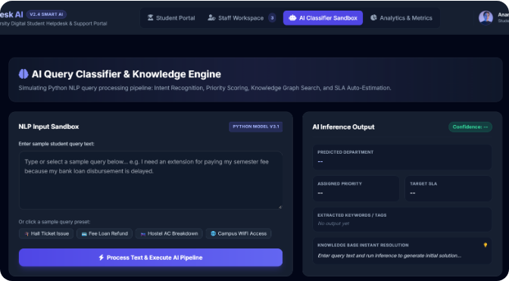
08. APPLICATION FEATURE WALKTHROUGH
Python NLP Query Classifier Sandbox
Interactive NLP Sandbox
Simulates entity extraction, intent recognition, and knowledge base lookups.
Preset Testing Scenarios
Pre-loaded sample queries for Hall Tickets, Fee Refunds, Hostel AC, and Campus WiFi.
Confidence Score Metrics
Evaluates AI classification reliability before committing routing decisions.

Slide 10
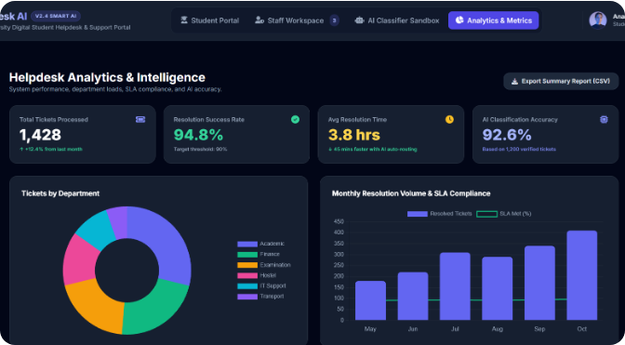
09. APPLICATION FEATURE WALKTHROUGH
Analytics & Helpdesk Operational Metrics
Chart.js Visualizations
Dynamic doughnut breakdown of department volume and monthly SLA trendlines.
KPI Performance Metrics
Tracks 1,428 processed tickets, 94.8% success rate, and 3.8h avg resolution time.
One-Click CSV Export
Generates downloadable operational reports for university leadership audits.

Slide 11
10. MEASURED RESULTS
Measured Operational Impact
3.8h
92.6%
96.4%
Average Resolution Time
AI Classification Precision
SLA Compliance Rate
Reduced from 48 hours traditional paper processing
Validated across 1,200+ multi-department queries
Maintained across all 6 administrative cells

Slide 12
CODESPARK HACKATHON 2026
Thank You! Questions?
EduDesk AI — Digital Student Helpdesk Platform

